Slide 1
Emphasis on Arm-DSP Communication
KeyStone II
Inter-Processor Communication
Using MsgCom
Notes:
1
NEW

Slide 2
Agenda
Overview
MsgCom Library
Channel Types
Interrupt Types
Blocking
ARM-DSP Requirements
Resource Manager
Packet Library
Job Scheduler (JOSH)
Agent
Debugging Tips

Slide 3
MsgCom Library
Purpose: To exchange messages between a reader and writer.
Read/write applications can reside:
On the same DSP core
On different DSP cores
On both the ARM and DSP core
Channel and interrupt-based communication:
Channel is defined by the reader (message destination) side
Supports multiple writers (message sources)

Slide 4
Channel Types
Simple Queue Channels: Messages are placed directly into a destination hardware queue that is associated with a reader.
Virtual Channels: Multiple virtual channels are associated with the same hardware queue.
Queue DMA Channels: Messages are copied using infrastructure PKTDMA between the writer and the reader.
Proxy Queue Channels: Indirect channels work over BSD sockets; Enable communications between Writer and Reader that are not connected to the same instance of Multicore Navigator.

Slide 5
Interrupt Types
No interrupt: Reader polls until a message arrives.
Direct Interrupt:
Low-delay system
Special queues must be used.
Accumulated Interrupts:
Special queues are used.
Reader receives an interrupt when the number of messages crosses a defined threshold.

Slide 6
Blocking and Non-Blocking
Blocking: Reader can be blocked until message is available.
Blocked by software semaphore which BIOS assigns on DSP side
Also utilizes software semaphore on ARM side, taken care of by Job Scheduler (JOSH)
Implementation of software semaphore occurs in OSAL layer on both ARM and DSP.
Non-blocking:
Reader polls for a message.
If there is no message, it continues execution.

Slide 7
Case 1: Generic Channel Communication Zero Copy-based Constructions: Core-to-Core
NOTE: Logical function only
hCh=Find(“MyCh1”);
hCh = Create(“MyCh1”);
Reader
Writer
MyCh1
Tibuf *msg = PktLibAlloc(hHeap);
Put(hCh,msg);
Tibuf *msg =Get(hCh);
PktLibFree(msg);
Delete(hCh);
Reader creates a channel ahead of time with a given name (e.g., MyCh1).
When the Writer has information to write, it looks for the channel (find).
Writer asks for a buffer and writes the message into the buffer.
Writer does a “put” to the buffer. Multicore Navigator does it – magic!
When Reader calls “get,” it receives the message.
Reader must “free” the message after it is done reading.
Notes:
Notes:
All naming is illustrative.
Open Items:
Recycling policies on Tx Completion queues
API Naming convention

Slide 8
Case 2: Low-Latency Channel Communication Single and Virtual Channel Zero Copy-based Construction: Core-to-Core
NOTE: Logical function only
Reader
Writer
hCh = Create(“MyCh2”);
MyCh2
Posts internal Sem and/or callback posts MySem;
hCh=Find(“MyCh2”);
chRx
(driver)
Get(hCh); or Pend(MySem);
Tibuf *msg = PktLibAlloc(hHeap);
Put(hCh,msg);
PktLibFree(msg);
hCh=Find(“MyCh3”);
MyCh3
hCh = Create(“MyCh3”);
Tibuf *msg = PktLibAlloc(hHeap);
Get(hCh); or Pend(MySem);
Put(hCh,msg);
PktLibFree(msg);
Reader creates a channel based on a pending queue. The channel is created ahead of time with a given name (e.g., MyCh2).
Reader waits for the message by pending on a (software) semaphore.
When Writer has information to write, it looks for the channel (find).
Writer asks for buffer and writes the message into the buffer.
Writer does a “put” to the buffer. Multicore Navigator generates an interrupt . The ISR posts the semaphore to the correct channel.
Reader starts processing the message.
Virtual channel structure enables usage of a single interrupt to post semaphore to one of many channels.
Notes:
Notes:
All naming is illustrative.
Open Items:
Recycling policies on Tx Completion queues
API Naming convention

Slide 9
Case 3: Reduce Context Switching Zero Copy-based Constructions: Core-to-Core
NOTE: Logical function only
Reader
Writer
hCh = Create(“MyCh4”);
hCh=Find(“MyCh4”);
MyCh4
Tibuf *msg =Get(hCh);
Tibuf *msg = PktLibAlloc(hHeap);
chRx
(driver)
Put(hCh,msg);
Accumulator
PktLibFree(msg);
Delete(hCh);
Reader creates a channel based on an accumulator queue. The channel is created ahead of time with a given name (e.g., MyCh4).
When Writer has information to write, it looks for the channel (find).
Writer asks for buffer and writes the message into the buffer.
Writer does a “put” to the buffer. Multicore Navigator adds the message to an accumulator queue.
When the number of messages reaches a threshold, or after a pre-defined time out, the accumulator sends an interrupt to the core.
Reader starts processing the message and makes it “free” after it is done.
Notes:
Notes:
All naming is illustrative.
Open Items:
Recycling policies on Tx Completion queues
API Naming convention

Slide 10
Case 4: Generic Channel Communication ARM-to-DSP Communications via Linux Kernel VirtQueue
NOTE: Logical function only
Reader
Writer
hCh = Create(“MyCh5”);
hCh=Find(“MyCh5”);
MyCh5
Tibuf *msg =Get(hCh);
msg = PktLibAlloc(hHeap);
Put(hCh,msg);
Tx
PKTDMA
Rx
PKTDMA
PktLibFree(msg);
Delete(hCh);
Reader creates a channel ahead of time with a given name (e.g., MyCh5).
When Writer has information to write, it looks for the channel (find). The kernel is aware of the user space handle.
Writer asks for a buffer. The kernel dedicates a descriptor to the channel and provides Writer with a pointer to a buffer that is associated with the descriptor. Writer writes the message into the buffer.
Writer does a “put” to the buffer. The kernel pushes the descriptor into the right queue. Multicore Navigator does a loopback (copies the descriptor data) and frees the Kernel queue. Multicore Navigator then loads the data into another descriptor and sends it to the appropriate core.
When Reader calls “get,” it receives the message.
Reader must “free” the message after it is done reading.
Notes:
Notes:
All naming is illustrative.
Open Items:
Recycling policies on Tx Completion queues
API Naming convention

Slide 11
Case 5: Low-Latency Channel Communication ARM-to-DSP Communications via Linux Kernel VirtQueue
NOTE: Logical function only
hCh = Create(“MyCh6”);
Reader
Writer
MyCh6
chIRx
(driver)
Get(hCh); or Pend(MySem);
hCh=Find(“MyCh6”);
msg = PktLibAlloc(hHeap);
Put(hCh,msg);
Tx
PKTDMA
Rx
PKTDMA
PktLibFree(msg);
Delete(hCh);
PktLibFree(msg);
Reader creates a channel based on a pending queue. The channel is created ahead of time with a given name (e.g., MyCh6).
Reader waits for the message by pending on a (software) semaphore.
When Writer has information to write, it looks for the channel (find). The kernel space is aware of the handle.
Writer asks for a buffer. Kernel dedicates a descriptor to the channel and provides Writer with a pointer to a buffer associated with the descriptor. Writer writes message to the buffer.
Writer does a “put” to the buffer. The kernel pushes the descriptor into the right queue. Multicore Navigator does a loopback (copies the descriptor data) and frees the kernel queue. Multicore Navigator then loads the data into another descriptor, moves it to the right queue, and generates an interrupt. The ISR posts the semaphore to the correct channel.
Reader starts processing the message.
Virtual channel structure enables usage of a single interrupt to post semaphore to one of many channels.
Notes:
Notes:
All naming is illustrative.
Open Items:
Recycling policies on Tx Completion queues
API Naming convention

Slide 12
Case 6: Reduce Context Switching ARM-to-DSP Communications via Linux Kernel VirtQueue
NOTE: Logical function only
hCh=Find(“MyCh7”);
hCh = Create(“MyCh7”);
Reader
Writer
MyCh7
Msg = Get(hCh);
chRx
(driver)
msg = PktLibAlloc(hHeap);
Put(hCh,msg);
Tx
PKTDMA
Rx
PKTDMA
Accumulator
PktLibFree(msg);
Delete(hCh);
Reader creates a channel based on one of the accumulator queues. The channel is created ahead of time with a given name (e.g., MyCh7).
When Writer has information to write, it looks for the channel (find). The kernel space is aware of the handle.
Writer asks for a buffer. The kernel dedicates a descriptor to the channel and gives Writer a pointer to a buffer that is associated with the descriptor. Writer writes the message into the buffer.
Writer does a “put” to the buffer. The kernel pushes the descriptor into the right queue. Multicore Navigator does a loopback (copies the descriptor data) and frees the kernel queue. Multicore Navigator then loads the data into another descriptor and adds the message to an accumulator queue.
When the number of messages reaches a threshold, or after a pre-defined time out, the accumulator sends an interrupt to the core.
Reader starts processing the message and frees it after it is complete.
Notes:
Notes:
All naming is illustrative.
Open Items:
Recycling policies on Tx Completion queues
API Naming convention

Slide 13
Steps on the ARM Side
Initialize Msgcom.
Create a thread to run Agent Receive.
Create thread to run writer/reader tasks:
Create/find channel
Allocate and populate data buffer
Msgcom_putMessage
Wait for message “delete channel”
Delete “named resource” on ARM side
Use Agent to push deleted “named resource” to remote processor.

Slide 14
Steps on the DSP Side
Call Ipc_start()
Initialize resource manager
Initialize and configure Qmss and Cppi
Initialize and configure shared heap
Initialize Msgcom
Initialize Agent and Agent Rx
Create Msgcom channel
Msgcom_getMessage
Invalidate message and get data buffer, then invalidate buffer
Free message
Delete Msgcom channel

Slide 15
Agenda
Overview
MsgCom Library
Channel Types
Interrupt Types
Blocking
ARM-DSP Requirements
Resource Manager
Packet Library
Job Scheduler (JOSH)
Agent
Debugging Tips

Slide 16
ARM-DSP Requirements

Slide 17
ARM-DSP Requirements
Msgrouter
Resource Manager
Packet Library
Job Scheduler (JOSH)
Agent

Slide 18
Msgrouter
Msgrouter creates special msgcom channels known as “control channels” or “control path.”
Control channels are used for system messages and synchronization purposes.
Agent module (more details later) runs consistently while waiting for messages on these control channels.
“ARM created a new data channel. Let the DSP know by sending a message over the control path.”

Slide 19
Resource Manager
Ensures that system resources can be requested and granted access without conflict. Displays an error during system initialization if requested resources are greater than system limitations.
Maintains database of system resources:
ARM and DSP have separate instances of this database.
Agent is used to sync resources within these databases.
Synchronizes system resources:
ARM created a new resource; For example, msgcom data channel.
ARM updates its own Resource Manager Database.
Agent creates a Job Scheduler (JOSH) packet indicating that this is a new resource with name and corresponding data.
This JOSH packet is pushed by control channels to DSP.
DSP Resource Manager Database gets updated with this information.
Example system resources: general purpose queues, accumulator channels, hardware semaphores, direct interrupt queues, CPINTC interrupts, memory region requests, etc.

Slide 20
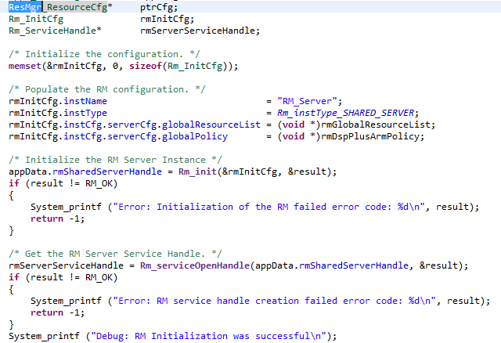
DSP Resource Manager Setup

Slide 21
Packet Library
Packet infrastructure implemented within Queue Manager Subsystem (QMSS)
High-level library to allocate packets and manipulate packets used by different types of channels
Enhance Heap manipulation

Slide 22
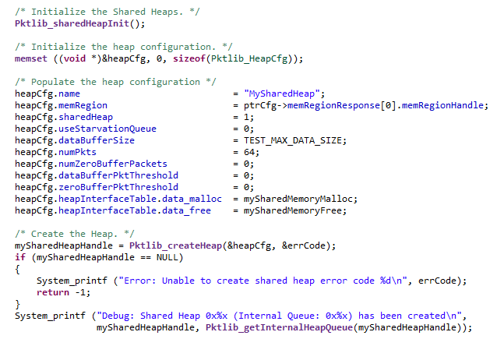
Heap Initialization PktLib

Slide 23
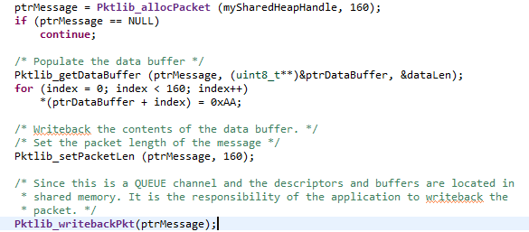
Packet Creation PktLib

Slide 24
Job Scheduler (JOSH)
Allows function call made on one processing element to be executed on another processing element
Defines a prototype for a job/function call
Enables DSP to understand what ARM is saying (and vice versa); “Execute function X on DSP.”
Common message type required
This is JOSH!
User application does not directly exercise any of the JOSH APIs.

Slide 25
Agent
The Agent module implements remote procedure calls between the ARM and the DSP.
Main purpose is to synchronize resources between ARM and DSP.
Utilizes msgcom control path to sync updates about resources
Creation, deletion, modification
Separate instance of Agent is required for each DSP core.

Slide 26
DSP Agent Creation
Agent has to be initialized on the DSP before any remote function calls are made.
Agent initialization requires a shared memory address in DDR3; Must reserve 4096 bytes of memory in DSP linker.
Next, the Agent must be created.
Finally, the Agent must be synced.

Slide 27
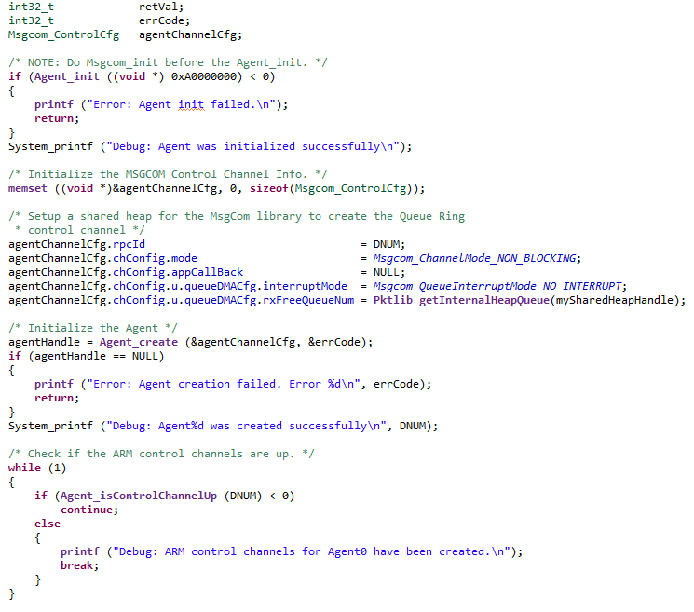
DSP Agent Rx Task (1/2)

Slide 28
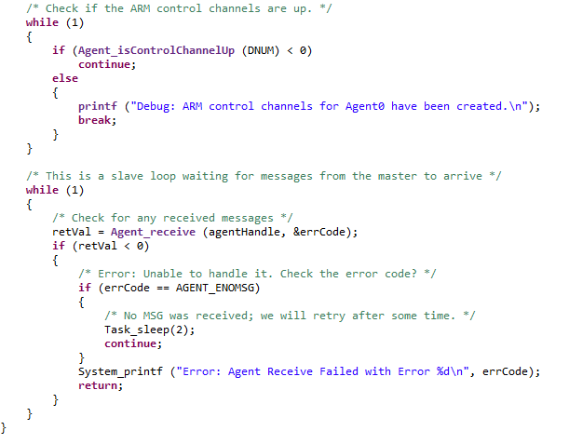
DSP Agent Rx Task (2/2)

Slide 29
ARM Agent Initialization
ARM processes must register with MSGRouter app before they can utilize the service.
The configuration passed to the API includes:
Local Identifier identifies ARM process
Remote Identifier is the DSP core number to where all JOSH requests issued by ARM are sent.
Default Process indicates if the application will receive a JOSH request from a DSP core.

Slide 30
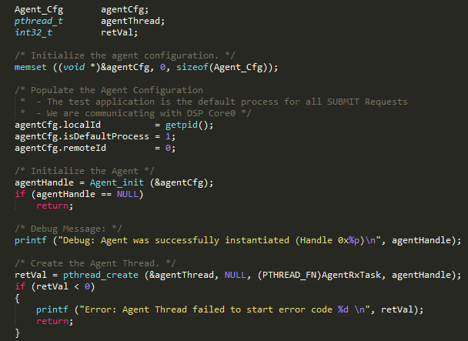
ARM Agent Init Code Example

Slide 31
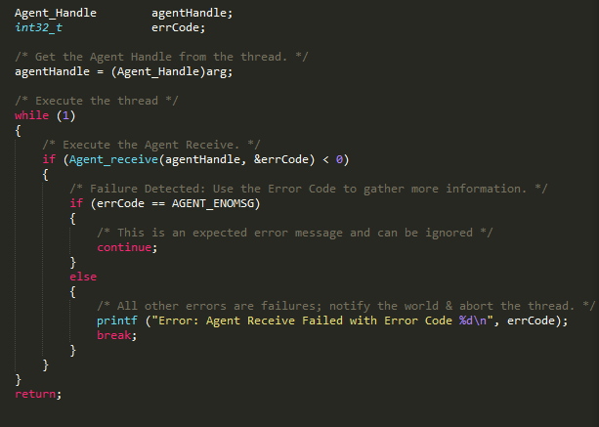
Agent Receive
The Agent Receive API has to be called on both the ARM and DSP to receive remote function. .call. requests

Slide 32
Agenda
Overview
MsgCom Library
Channel Types
Interrupt Types
Blocking
ARM-DSP Requirements
Resource Manager
Packet Library
Job Scheduler (JOSH)
Agent
Debugging Tips

Slide 33
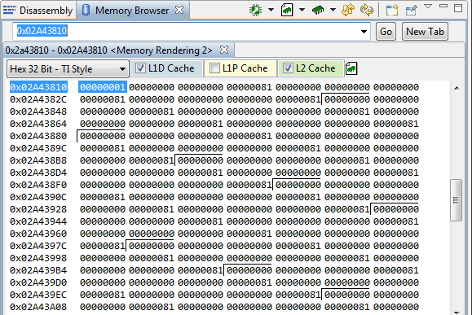
Debugging
Look up the channel database in Expressions window.
Locate created channels and their corresponding queue numbers.
Memory address for queue is 0x02A4 + QueueNum << 4
Place breakpoints at msgcom_getMessage and msgcom_putMessage and check this memory address to ensure packet is put/get

Slide 34
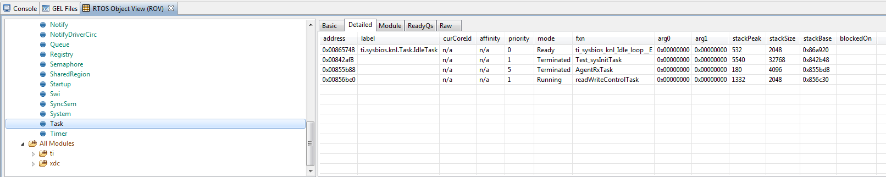
Debugging
Launch RTOS Object View (ROV) from Tools -> ROV.
Select Task, then click the “Detailed” tab.
Helpful for seeing if put/get is pending on semaphore

Slide 35
For More Information
For more information, refer to the KeyStone Multicore: DSP+ARM start page to locate the data manual for your KeyStone II device.
View the complete C66x Multicore SOC Online Training for KeyStone Devices, including details on KeyStone II and the ARM CorePac.
For questions regarding topics covered in this training, visit the support forums at the TI E2E Community website.
Notes:
NEW

